Slide 1

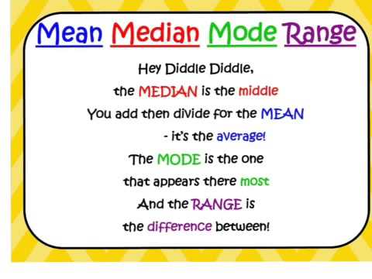
My Statistics Interactive Notebook
Name:
Year 8 Maths
Teacher: Mr Summers
Term 3 Semester 2

Slide 2


Slide 3
Warm Up
Arrange the following in ascending order:
2, 4, 7, 1, 0, 10, 6, 14, 9
101, 20, 30.6, 204, 26, 100
1.2, 2.9, 2.7, 1.9, 3.5, 3.2
Find the value(s) that occur the most in the following lists:
2,3,1,5,2,7,8,5,10,9,10
a,a,a,b,c,d,c,d,b,b,e,f,a
blue, orange, red, yellow, green, orange, green

Slide 4
24
7
30
Date
Measures of Location
EQ – What are some examples of descriptive statistics and what do we use them for?
What are measures of
location?
The three most common measures of location are the mean, the median, and the mode.
How do we find the measures of location?
Mean
Most commonly used measure of central tendency
Also known as the Average of all observations.
It is the sum of all the scores divided by the number of scores

Slide 5
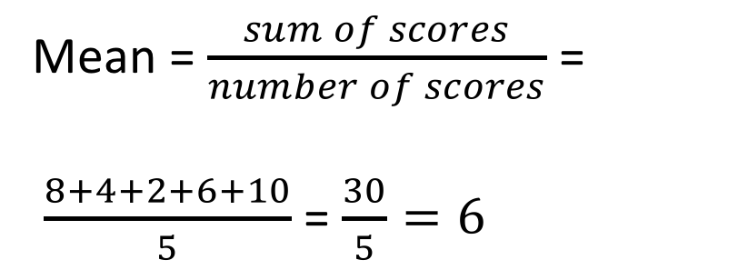
24
7
30
Date
Measures of Location
EQ – What are the measures of location in statistics and how do we find them?
How do we find the measures of location?
Example 1
Data: 8, 4, 2, 6, 10
Mean = $\frac{sum of scores}{number of scores}$ =
$\frac{8+4+2+6+10}{5}$ = $\frac{30}{5}=6$

Slide 6
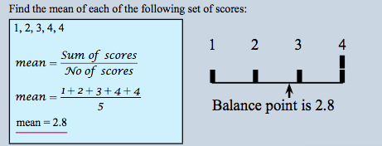
24
7
30
Date
Measures of Location
EQ – What are the measures of location in statistics and how do we find them?
How do we find the measures of location?
Example 2

Slide 7
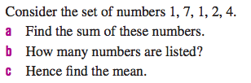
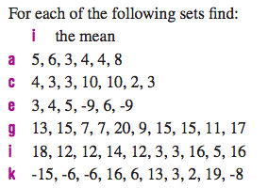
Your Turn

Slide 8
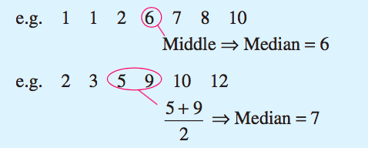
24
7
30
Date
Measures of Location
EQ – What are the measures of location in statistics and how do we find them?
How do we find the measures of location?
Median – This is the middle value if the values are in order (ascending or descending). If there are two middle values then the average of them is taken, by adding them together and dividing by 2.

Slide 9
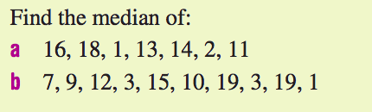
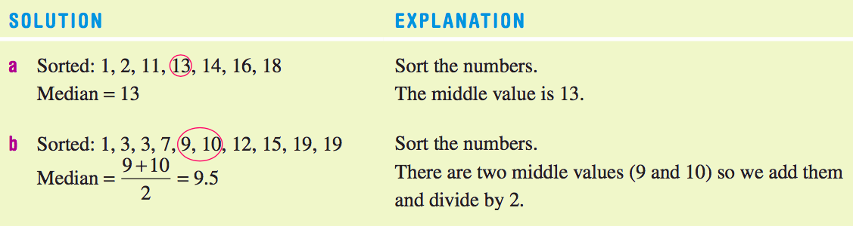
Your turn

Slide 10
Complete the first two rows (mean and median) from your Mean, median, Mode and Range worksheet

Slide 11
Exit Slip
On the paper you’ve been handed:
Define Mean and Median
Write an example for both

Slide 12
Notes Review
24, 7 ,30
Date
Title
Essential question
Notes complete
Notes complete with colour and diagrams
Questions completed
Contents page filed in
Formula page filled in

Slide 13
Homework
Review your notes and write a summary answering the essential question.

